Slide 1
Chapter6 (Lecture1)
Structuring System Requirements: Process Modeling

Slide 2
Use-Case Diagrams
When analyzing CBISs, we use Use-Case diagrams to help us collect the requirements for the CBISs.
Notes:
laypeople’s الناس العاديين/العامة

Slide 3
Use-Case Diagrams
What is Use-Case Diagram?
* It is a diagram that provides the high-level view of the system and convey the requirements in laypeople's terms for the stakeholders.
* A use-case diagram is a set of use cases
Notes:
laypeople’s الناس العاديين/العامة

Slide 4
Use-Case Diagrams (Cont.)
A use case is a model of the interaction between external users of a software product (actors) and the software product itself.
More precisely, an actor is a user playing a specific role.
Describing a set of user scenarios.
Capturing user requirements.
Contract between end user and software developers.
Notes:
laypeople’s الناس العاديين/العامة

Slide 5
Use Cases
Use case diagrams describe what a system does from the standpoint of an external observer. The emphasis is on what a system does rather than how.
Use case diagrams are closely connected to scenarios. A scenario is an example of what happens when someone interacts with the system.

Slide 6
Use Case Diagram for A Library System
Use Case
Boundary
Actor
Library System
Borrow
Employee
Client
Order Title
Fine Remittance
Supervisor

Slide 7
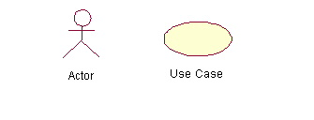
Use-Case Diagrams
Actors: A role that a user plays with respect to the system, including human users and other systems.
Use case: A set of scenarios that describing an interaction between a user and a system, including alternatives.
System boundary: rectangle diagram representing the boundary between the actors and the system.

Slide 8
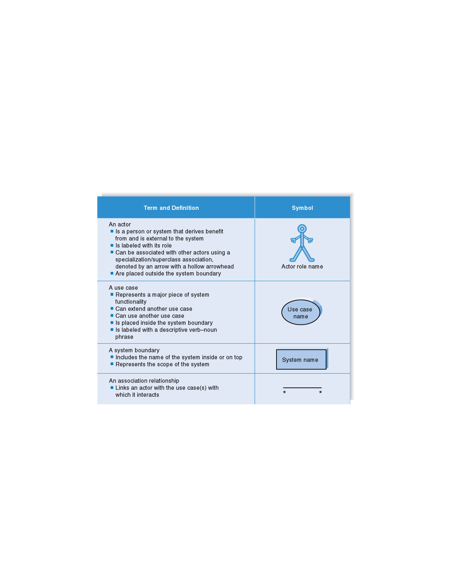
Syntax for Use Case Diagram

Slide 9
Use Cases
What is a Use Case
  A formal way of representing how a business system interacts with its environment
  Illustrates the activities that are performed by the users of the system
  A scenario-based technique in the UML
  A sequence of actions a system performs that yields a valuable result for a particular actor.

Slide 10
Use Case Diagram - Use Case
A major process performed by the system that benefits an actor(s) in some way
Models a dialogue between an actor and the system
Represents the functionality provided by the system
Notes:
Use Case
Represent the user functionality (not system functionality)

Slide 11
Use Case
Each use case in a use case diagram describes one and only one function in which users interact with the system
  May contain several “paths” that a user can take while interacting with the system
  Each path is referred to as a scenario
Notes:
Use Case
In reading a use case, you should not be able to tell if an activity is computerized or manual
Used to document the current system (AS-IS system) or the new system being developed (TO-BE system)
Communicates at a high level what the system needs to do
Captures the typical interaction of the system with the system’s users
Logical model
Physical details are defined during the design phase

Slide 12
Use Case Analysis
What is an Actor?
  A user or outside system that interacts with the system being designed in order to obtain some value from that interaction
Use Cases? describe scenarios that describe the interaction between users of the system (the actor) and the system itself.

Slide 13
Use Cases
Here is a scenario for a medical clinic.
A patient calls the clinic to make an appointment for a yearly checkup. The receptionist finds the nearest empty time slot in the appointment book and schedules the appointment for that time slot. "
We want to write a use case for this scenario.
Remember: A use case is a summary of scenarios for a single task or goal.

Slide 14
Use Cases
Step 1 Identify the actors
As we read the scenario, define those people or systems that are going to interact with the scenario.
A patient calls the clinic to make an appointment for a yearly checkup. The receptionist finds the nearest empty time slot in the appointment book and schedules the appointment for that time slot. "

Slide 15
Questions for Identifying People Actors
Who is interested in the scenario/system?
Where in the organization is the scenario/system be used?
Who will benefit from the use of the scenario/system?
Who will supply the scenario/system with this information, use this information, and remove this information?
Does one person play several different roles?
Do several people play the same role?
Notes:
Actors
7) Does one person play several different roles?
May have an actor for each role
8) Do several people play the same role?
Only use one actor per role (no matter how many people play that role)
Identifying actors is an iterative process
Defining how an actor interacts with the system may clarify whether there are duplicate actors or not

Slide 16
Questions for Identifying Other Actors
What other entity is interested in the scenario/system?
What other entity will supply the scenario/system with this information, use this information, and remove this information?
Does the system use an external resource?
Does the system interact with a legacy system?
Notes:
Actors
7) Does one person play several different roles?
May have an actor for each role
8) Do several people play the same role?
Only use one actor per role (no matter how many people play that role)
Identifying actors is an iterative process
Defining how an actor interacts with the system may clarify whether there are duplicate actors or not

Slide 17
Actors
An Actor is outside or external the system.
It can be a:
  Human
  Peripheral device (hardware)
  External system or subsystem
  Time or time-based event
Represented by stick figure
Notes:
Actors
Are NOT a part of the system (external to the system)
A single actor may represent multiple physical users
Whether human or not, represented by stick figure
MUST label stick figure with the name of the actor

Slide 18
Use Cases
An actor is who or what initiates the events involved in the task of the use case. Actors are simply roles that people, or objects play.
So as we read our scenario, what or who is the actor????

Slide 19

Use Case - Actor
Labelled using a descriptive noun or phrase
Represented by a stick character
Notes:
Actors: An actor portrays any entity (or entities) that performs certain roles in a given system. The different roles the actor represents are the actual business roles of users in a given system. An actor in a use case diagram interacts with a use case. For example, for modeling a banking application, a customer entity represents an actor in the application. Similarly, the person who provides service at the counter is also an actor. But it is up to you to consider what actors make an impact on the functionality that you want to model. If an entity does not affect a certain piece of functionality that you are modeling, it makes no sense to represent it as an actor. An actor is shown as a stick figure in a use case diagram depicted "outside" the system boundary, as shown in Make Appointment figure.
Depicted by an oval
MUST label the oval with the name of the use case
To identify an actor, search in the problem statement for business terms that portray roles in the system. For example, in the statement "patients visit the doctor in the clinic for medical tests," "doctor" and "patients" are the business roles and can be easily identified as actors in the system.

Slide 20
Use Cases
So as we read our scenario, what or who is the actor????
A patient calls the clinic to make an appointment for a yearly checkup. The receptionist finds the nearest empty time slot in the appointment book and schedules the appointment for that time slot. "
The actor is a Patient.

Slide 21
Use Cases
The use case is a summary of scenarios for a single task or goal.
So What is the Use Case????
The Use Case is Make Appointment.
It is a use case for the medical clinic.

Slide 22
Use Case
Labelled using a descriptive verb-noun phrase
Represented by an oval
Make
Appointment
Notes:
Use case: A use case in a use case diagram is a visual representation of a distinct business functionality in a system. The key term here is "distinct business functionality." To choose a business process as a likely candidate for modeling as a use case, you need to ensure that the business process is discrete in nature. As the first step in identifying use cases, you should list the discrete business functions in your problem statement. Each of these business functions can be classified as a potential use case. Remember that identifying use cases is a discovery rather than a creation. As business functionality becomes clearer, the underlying use cases become more easily evident. A use case is shown as an ellipse in a use case diagram Depicted by an oval
MUST label the oval with the name of the use case

Slide 23
Use Case Components
The use case has three components.
The use case task referred to as the use case that represents a feature needed in a software system.
The actor(s) who trigger the use case to activate.
The communication line to show how the actors communicate with the use case.

Slide 24
Use Case - Relationships
Relationships
  Represent communication between actor and use case
  Depicted by line or double-headed arrow line
  Also called association relationship
Make
Appointment
Notes:
Use Case Relationship
Association relationship
May exist between actor and a use case
Often referred to as a communicate association
Navigable in both directions (actor to use case and use case to actor)
Some use just a line
Others use a double-headed arrowhead
Navigable in only one direction (actor to use case OR use case to actor)
Use a arrowhead where arrowhead denotes the direction of communication
Navigation direction of an association represents who is initiating the communication
Multiplicity
Not consistency shown on all use-case diagrams (Some do; some don’t)

Slide 25
Use Case - Relationships
Boundary
  A boundary rectangle is placed around the perimeter of the system to show how the actors communicate with the system.
Make
Appointment
Notes:
System boundary: A system boundary defines the scope of what a system will be. A system cannot have infinite functionality. So, it follows that use cases also need to have definitive limits defined. A system boundary of a use case diagram defines the limits of the system. The system boundary is shown as a rectangle spanning all the use cases in the system.
Other use cases in this lecture also show the system boundary of the clinic application. The use cases of this system are enclosed in a rectangle. Note that the actors in the system are outside the system boundary.
The system boundary is potentially the entire system as defined in the problem statement. But this is not always the case. For large and complex systems, each of the modules may be the system boundary. For example, for an ERP system for an organization, each of the modules such as personnel, payroll, accounting, and so forth, can form the system boundary for use cases specific to each of these business functions. The entire system can span all of these modules depicting the overall system boundary.

Slide 26

Use Cases
The picture below is a Make Appointment use case for the medical clinic.
The actor is a Patient. The connection between actor and use case is a communication association (or communication for short).
Actors are stick figures. Use cases are ovals. Communications are lines that link actors to use cases.

Slide 27
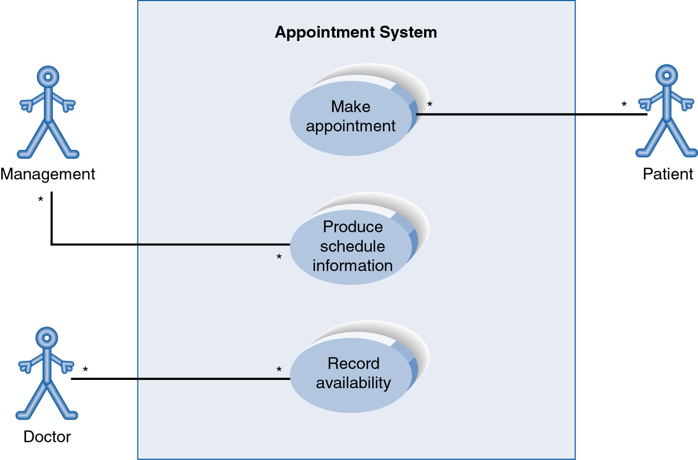
Use Case Diagram for Appointment System
A use case diagram is a collection of actors, use cases, and their communications.
Notes:
Example Use Case
ACTORS
Represented by a stick figure
named
USE CASE
Represented by an oval
Named (POORLY NAMED; should be verb phrase)
RELATIONSHIP
2-way association

Slide 28
Thank You
Notes:
5
5

